Slide 1


Weakly Supervised Person Name Transliteration using Twitter Data
Advanced Topics in Computer Science Course

Slide 2
What is transliteration?
Converting a word from one writing system to another
Directly express through sounds
Transliteration is NOT translation

Slide 3
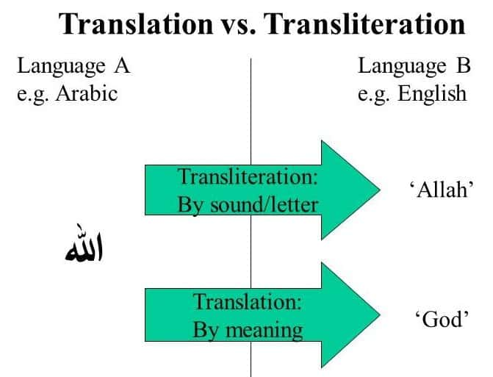

Slide 4
Why keep looking into transliterating?
Standard transliteration systems already exist

Slide 5
Why keep looking into transliterating?
Standard transliteration systems already exist
Many self-transliterate
We are trying to capture this informal transliteration process
Counter-point

Slide 6

A real-life application
Security vetting

